Slide 1
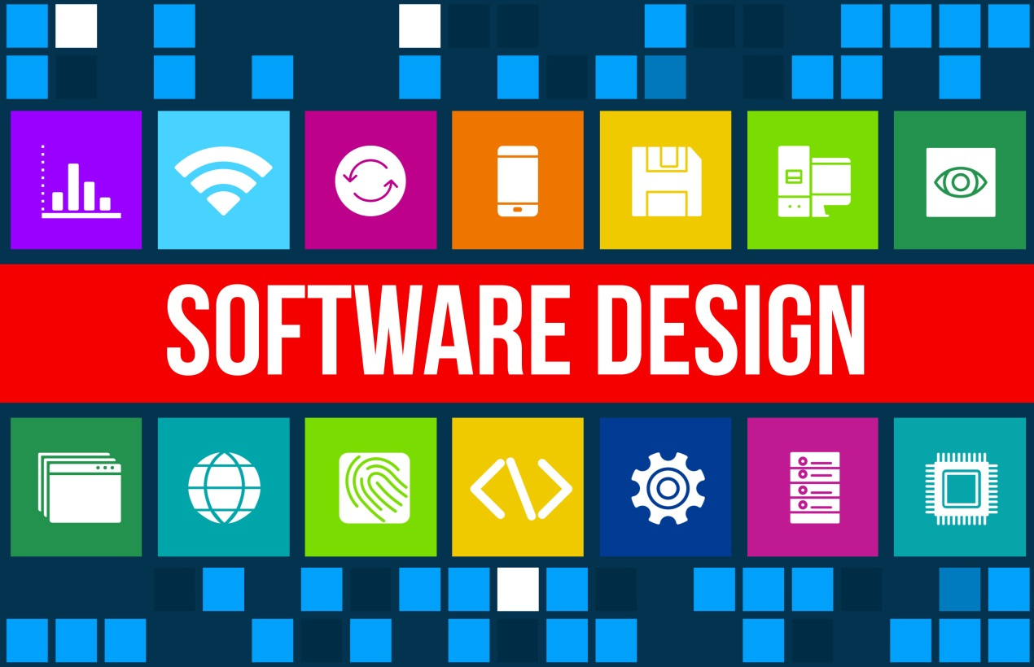
Block chain team

Slide 2
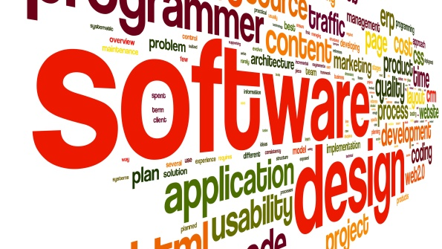
Software design
Software design is the process of defining software methods, functions, objects, and the overall structure and interaction of your code so that the resulting functionality will satisfy your user’s requirements.

Slide 3
The Hierarchical of
Software Design

Slide 4
CONTENTS
Architectural Design
Component Design
Interface Design
Database Design
UML
Model

Slide 5
01
Architectural
Design

Slide 6
Architecture Design
Architectural Design
Module
Structure
C&C
Structure
Allocation
Structure
Notes:
Module:
1.Decomposition structure. How to divide system into subsystem. Modifiability
2.Uses structure. A specialized form of dependency. Extensibility
3.Layer structure. A layer only allowed to use the layer immediately below by a managed fashion. Portability
4.Class structure. Support reasoning about the collections of similar behavior and parameterized differences. Modifiability Extensibility
5.Data model. Describe the static information structure in terms of data entities and their relationship. Modifiability Performance
C&C:
1.service structure. Services that interoperate with each other by service coordination mechanisms. Scheduling analysis, performance analysis. Interoperability Modifiability
2.Concurrency structure. Identifying locations where resource contention exists, or where threads may fork, join, be created, or be killed. Performance Availability
Allocation:
1.deployment structure. Show how software is assigned to hardware processing and communication elements. Performance Security Availability
2. Implementation structure. Show how modules stored in file structure. Development efficiency.
3.Work assignment structure. Assigned modules to organizational units. Development efficiency.

Slide 7
02
Component
Design

Slide 8
Component Design
Component Design
Acyclic
Dependencies
Reuse/Release
Equivalence
Design Principles
Common Reuse
Stable-Dependencies
Common
Closure
Stable-Abstraction

Slide 9
03
Interface
Design

Slide 10
Interface Design
Interface Design
User
Interface
External
Interface
Internal
Interface

Slide 11
04
Database
Design

Slide 12
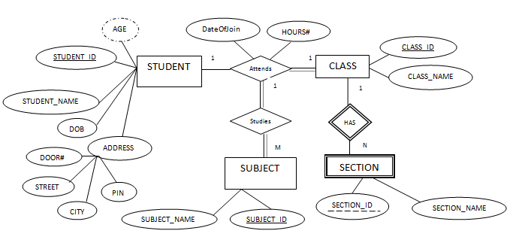
Database Design
We use the ER diagram to make the database design.
An entity–relationship diagram (ER diagram) describes inter-related things of interest in a specific domain of knowledge

Slide 13
05
UML
Model

Slide 14
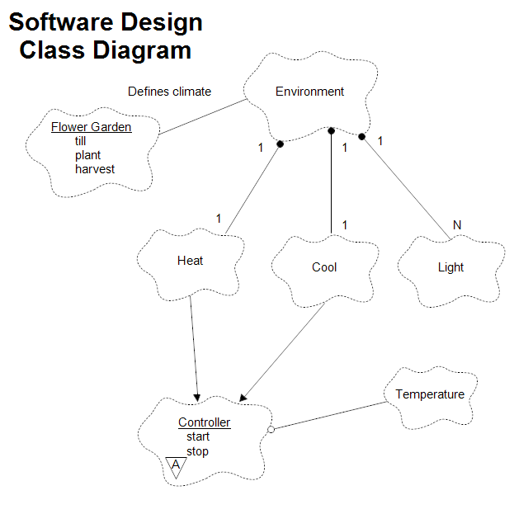
UML Model
Class Diagram

Slide 15
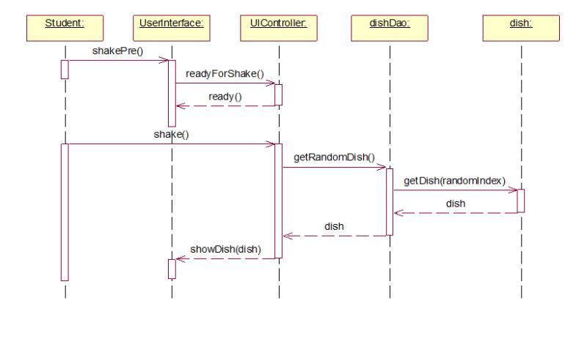
UML Model
Sequence Diagram

Slide 16
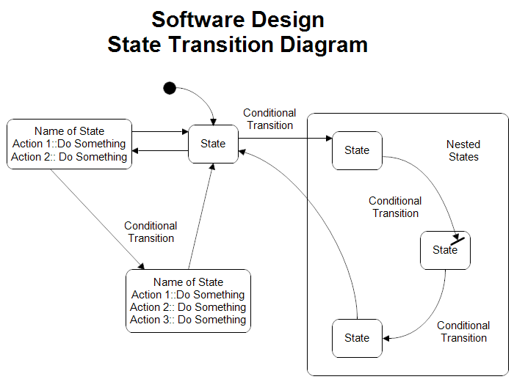
UML Model
State Transition Diagram

Slide 17
THANK YOU
Block chain team

